Slide 1
Annual Project Report
UNDER THE GUIDANCE OF SAJAL MUKHOPADHYA

Slide 2
PROJECT 1: Strategic Voting
Understanding of Voting rules in Computer Science

Slide 3
1. Voting in Computer Science
1.Rank aggregation.
Here, voters correspond to “different ranking algorithms”.
A prediction problem where the goal is to come up with a ranked list, such as the Web pages most relevant to a search query.
It’s natural to try to combine all these different ranked lists and likely conflicting rankings into a “consensus ranking.”
The consensus ranking is somehow “better” or “more accurate” than the individual rankings.
conclusion :
The best pages are high on all of the lists.
A spam page is high on only a subset of the lists.

Slide 4
2. Crowdsourcing.
Here, voters correspond to “workers” .
For example, the voters could be workers on Mechanical Turk, or peer graders in a MOOC.
Each worker produces a ranking — about their most and least favorite options.
A natural goal is to summarize the workers’ results with a single ranking.

Slide 5
3. Participatory democracy.
Here, voters are, um, “voters”.
The systems currently in place typically use “k-approval voting” — each voter is told the overall budget (e.g., $1 million) and a list of project descriptions with costs.
The voter picks their k favorite projects, with sorted in decreasing order of the number of votes received, and funded in this order until the budget runs out.
A drawback with this system is that voters need not take into account projects’ costs (e.g., the k projects’ combined costs are allowed to exceed the budget), which results in more expensive projects being overrepresented

Slide 6
2. Examples of Voting Rules
2.1 Formalism
The point of a voting mechanism is to make a decision as a function of preferences.
let A denote a set of alternatives where each voter i has her own ranked list over the alternatives in A, and declares some ranked list Li to a voting mechanism.
A voting rule can then have two different forms, depending on whether its output is a full ranked list or just a single alternative (the “winner”). So it’s either a map of the form
L1, L2, . . . , Ln 7→ L ∗ , 2 where L ∗ is a ranking of A,
or a map
L1, L2, . . . , Ln 7→ a ∗ , where a ∗ ∈ A.
The map is used in the crowdsourcing application and political elections .

Slide 7
2.2 Majority Rule
Suppose there are only two alternatives (|A| = 2).
The voting rule is majority vote: elect that alternative that appears first in the largest number of voters’ lists.
If there is an even number of voters and a tie, break the tie in some canonical way, perhaps randomly.
Observe that the majority vote rule is strategy proof.
If we submit a false list i.e., reverse the order of the two alternatives, the only possible effect is to flip the winner from the alternative that you prefer to the other alternative.
.

Slide 8
MAJORITY RULE IMPLEMENTATION BY BAR PLOT:
Suppose there are only two alternatives (|A| = 2).
One obvious voting rule is majority vote:
elect that alternative that appears first in the largest number of voters’ lists.
Observe that the majority vote rule is strategy proof.
If you submit a false list (i.e.,
reverse the order of the two alternatives), the only possible effect is to flip the winner from
the alternative that you prefer to the other alternative.
If there is an
even number of voters and a tie, break the tie in some canonical way, perhaps randomly.

Slide 9
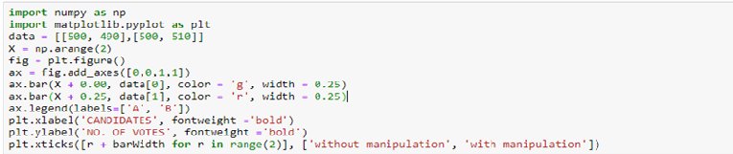
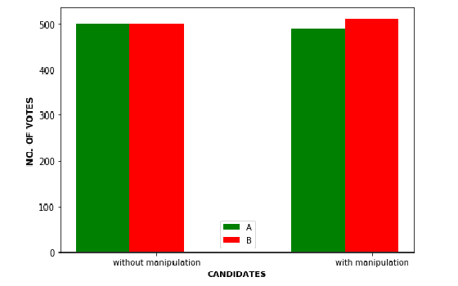
There is a tie between A and B.
(AFTER MANIPULATION)
If we submit a false list to preference A ,
B wins.
This holds the strategy proof ness.

Slide 10
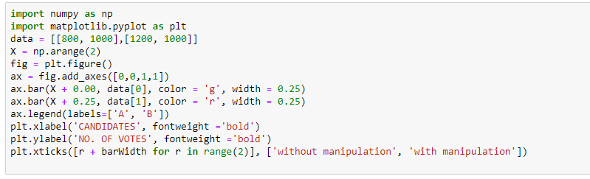
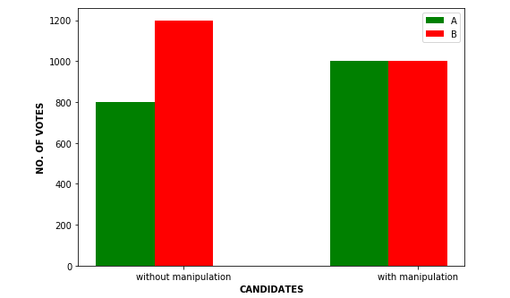
Here B is the winner .
(AFTER MANIPULATION)
If we submit a false list to preference B ,
here is a tie .
This holds the strategy proof ness.

Slide 11
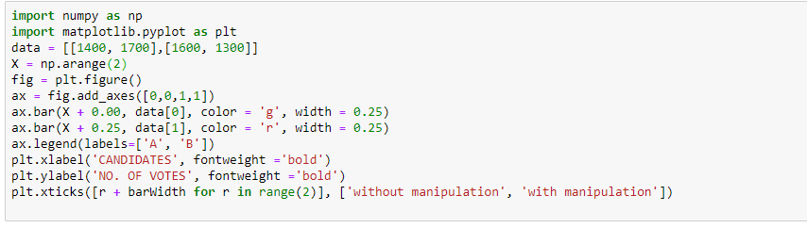
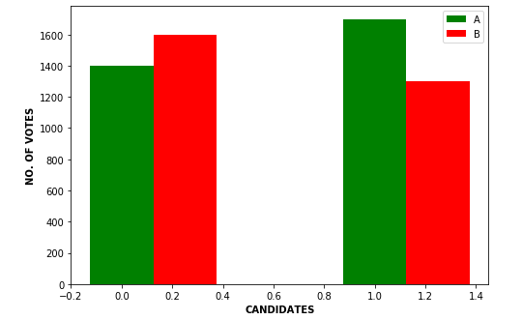
Here A is the winner .
(AFTER MANIPULATION)
If we submit a false list to preference B ,
A is the winner .
This holds the strategy proof ness.

Slide 12
2.3 Plurality Rule
Suppose there are only three alternatives (|A| = 3).
But in many real elections with 3 or more candidates, this does not happen. (E.g., with 3 candidates, you might have a 40/35/25 split.)
In most countries (including the U.S.), the most common solution is the plurality rule, which elects the candidate with the most first-place votes.
Candidate | Party Vote | Total
Bush | Republican | 2,912,790
Gore | Democrat | 2,912,253
Nader | Green | 97,488

Slide 13
This example also shows why the plurality rule is not strategy proof.
If your true preferences were to rank Nader over Gore over Bush, and if you knew that Nader had no chance of winning, then it makes sense to vote for Gore instead of Nader—this could cause your second-favorite candidate to get elected over your third-favorite candidate.
Thus Nader was a “spoiler” candidate, in the sense that his presence flipped the election’s outcome (from Gore to Bush), despite the fact that he was nowhere close to winning the election
conclusion :
Generally, the plurality rule tends to be biased toward “extreme” candidates.
c

Slide 14
2.4 Ranked-Choice Voting
Plurality rule has some serious issues. Another rule in the news is ranked-choice voting, also known as “single transferable vote” (STV) or “instant-runoff voting”.
For ranked-choice voting, voters submit a full ranked list (not just their first choice). First, if there is some alternative a ∗ that receives more than 50% of the first-choice votes, then a ∗ is the winner.
Otherwise, the alternative with the fewest first-choice votes is deleted and the winner is computed recursively on the remaining alternatives.
Eventually, there will be only two alternatives remaining at which point the rule is the same as the majority rule.

Slide 15
For example, consider the following five votes over the set of alternatives A = {a, b, c, d}.
Each of a, b, c has at least one first-choice vote, while d does not have any. So we eliminate d and recur on the remaining alternatives.
 | Voters #1,2 | Voters #1,2 | Voters #1,2
1st Choice | a | b | c
2nd Choice | d | a | d
3rd Choice | c | d | b
4th Choice | b | c | a

Slide 16
Since a, b have two first-choice votes each, while c only has one, we eliminate c and repeat:
 | Voters #1,2 | Voters #3,4 | Voters #5
1st Choice | a | b | c
2nd Choice | c | a | b
3rd Choice | b | c | a

Slide 17
In the last round we apply the majority rule, so b wins
 | Voters #1,2 | Voters #3,4,5
1st Choice | a | b
2nd Choice | b | a

Slide 18
2.5 The Borda Count
Voters submit their full ranked lists.
An alternative gets |A| points for each first-choice vote, |A| − 1 points for each second-choice vote, and so on, with 1 point for each last-choice vote.
The alternative with most points wins.

Slide 19
For example, with voter preferences as in Section 2.4, the point totals would be 15 for a, 12 for b, 10 for c, and 13 for d. Thus the Borda count would elect a (in contrast to the outcome of ranked choice voting).
 | Voters #1,2 | Voters #1,2 | Voters #1,2
1st Choice | a | b | c
2nd Choice | d | a | d
3rd Choice | c | d | b
4th Choice | b | c | a

Slide 20
3. The Gibbard-Satterthwaite and Arrow Impossibility Theorems
The Gibbard-Satterthwaite theorem states that it’s not our fault that we haven’t thought of any strategy proof voting rules with three or more alternatives—non-trivial such voting rules simply do not exist. To make a precise statement, we need to define a “non-trivial voting rule.”
Here are two “trivial” rules:
Dictator: a dictator rule has a dictator voter i, and always elects i’s first choice.
• Duple: a duple rule chooses a pair a, b ∈ A of alternatives (independent of voters’ preferences), and runs majority vote between a and b.

Slide 21
Theorem 3.1 (Gibbard-Satterthwaite Theorem )
“Every strategy proof voting rule that can produce at least three different outcomes is a dictator” .
So the Gibbard-Satterthwaite theorem basically says that strategy proof ness is hopeless in general for voting

Slide 22
Theorem 3.2 (Arrow’s Impossibility Theorem [1])
With three or more alternatives, no voting rule satisfies the following three properties:
1. Non-dictatorship.
2. Unanimity.
3. Independent of irrelevant alternatives (IIA).
Non-dictatorship just means that there is no dictator (a voter i such that the output of the voting rule is always the same as i’s ranked list).
Unanimity means if every voter ranks a over b, then the voting rule should also rank a over b.
IIA means that, for every pair a, b of alternatives, the relative order of a, b in the produced ranking should be a function only of the relative order of a, b in each voter’s list, and not depend on the position of any “irrelevant” alternative .

Slide 23
Observation
Most natural voting rules satisfy the first two conditions; IIA is the one that does most of the work (and is the most debatable as a desirable property).
For example, the plurality rule does not satisfy IIA; the outcome of the 2000 U.S.
Presidential Election was certainly not independent of the position of Nader in voters’ preference lists..

Slide 24
4 A. Tractable Special Case: Single-Peaked Preferences
The Gibbard-Satterthwaite theorem dashes any hopes of having a general and useful strategy proof voting rule.
So just as computational intractability results (like NP-hardness results) forces us to compromise our goals (resorting to approximation algorithms, restricting to computationally tractable special cases, etc.), impossibility theorems in voting theory imply that compromises must be made.

Slide 25
Suppose the set of alternatives is the unit interval [0, 1]. For example, the interval could represent the political spectrum (from radical to reactionary).
A voter i has single-peaked preferences if there is a “peak” pi ∈ [0, 1] such that whenever z is farther from pi than y (meaning z < y < pi or z > y > pi), the voter prefers y to z. See Figure 1.
0 Z y pi 1
Figure 1: Single-peaked preference. Voter i has peak pi ; since y is closer to pi than z, the voter prefers y to z.

Slide 26
Observation
One can imagine scenarios where single-peaked preferences are a reasonable first-cut approximation of voters’ preferences (electing a politician, locating a school, etc.).
Suppose each voter votes by providing a reported peak xi ∈ [0, 1]. One idea is to choose the average.
But this is not strategy proof: a voter might be able to pull the chosen outcome closer to her peak by reporting an overly extreme peak.

Slide 27
The median voting rule is strategy proof. The only way a voter can manipulate the median is to report a peak on the opposite side of the median from her true peak (Figure 2). But this can only pull the median farther away from her true peak, a worse outcome for her.
0 pi m 1
m’
0 pi 1
Figure 2: Median m of reported peaks (with n = 7)
A voter i with peak pi cannot change the median unless she overshoots to the other side by misreporting p 0 i ; this would move the median m’ even further from i’s true preference pi .

Slide 28
THE END
THANK YOU FOR BEARING WITH US.

